Slide 5
Students with a Positive Sense of Belonging
Source: OurSCHOOL student survey

Slide 6
Students that Value School Outcomes schooling outcomes
Source: OurSCHOOL student survey

Slide 7
Students who are Interested and Motivated
Source: OurSCHOOL student survey

Slide 8
Effort – Students Who Try Hard to Succeed
Source: OurSCHOOL student survey

Slide 9
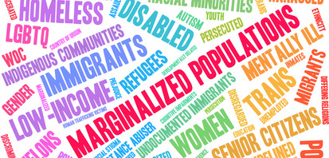

Slide 17
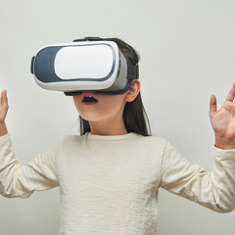
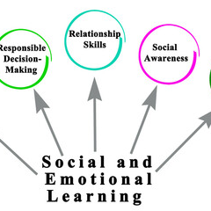
Best Practices of Career Education K-12
Experiential Learning
Labour Market Information Learning
SEL + Global Competency Learning
Financial Wellness Learning
myBlueprint online career/life planning

Slide 19
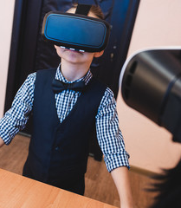
Experiential Learning

Slide 20
Social Emotional Learning and Global Competency Development

Slide 21
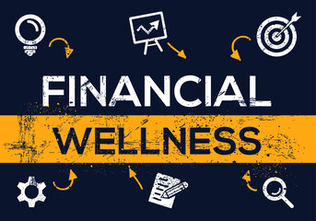
Financial Wellness for All Learners

Slide 22
myBlueprint Career/Life Planning Tool

Slide 25
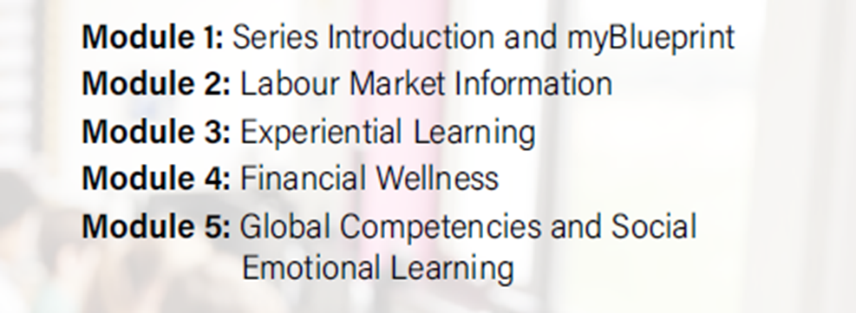
Educator Professional Learning

Slide 26
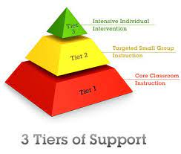
Practice Framework for Hopeful Transitions
Response to Intervention (RTI) model
Tier 1 – Universally designed career education K-12
Tier 2 – Targeted career education interventions
Tier 3 – Individual career development and transition interventions

Slide 27
Tricia Berry and Andrew Culberson
https://www2.gnb.ca/content/gnb/en/departments/education/k12/content/career-connected-learning.html

